Slide 1
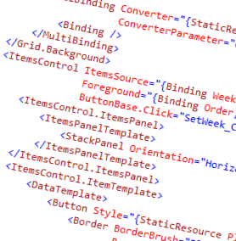
WPF and XAML
5.0 – Resources, Styles and Themes

Slide 2
Overview
What are resources?
Styles

Slide 3























▪

Slide 4
Types of resources
Static and Dynamic
Static resources are loaded once
Dynamic can be reloaded and changed

Slide 5


App.Resources
Page.Resources Other Pages…
Grid.Resources
Element
Element

Slide 6





















Slide 7
























Slide 8







Slide 9

Themes
Mass set of styles and control templates
Include as an app level resource
https://github.com/brianlagunas/InfragisticsThemesForMicrosoftControls
Dynamic:
Usually requires a restart

Slide 10
Summary
We took a look at resources, styles and themes
Resources provide a great means of reuse
Styles are resources that push visual elements on controls
Themes are styles and templates that replace many control styles and templates

Slide 11
Demo
Demonstration of styles and resources

